Slide 1

Idiographic Personality: A Methodological Perspective on Measuring and Modeling Individuals
Emorie D. Beck and Joshua J. Jackson
Washington University in St. Louis
Notes:
Hi everyone, my name is Emorie Beck, and I'm very excited to lead off today's discussion of the promises and challenges of idiographic methods by discussing idiographic work I've done in the domain of personality that I think applies to idiographic research more broadly.
Because I'm going to be using a personality framework, let me start with some quick background on personality

Slide 2
Extraversion
Agreeableness
Conscientiousness
Neuroticism
Openness
Nomothetic
Notes:
For many years, the Big 5 have been the dominant taxonomy of between person individual differences.
And for good reason. The Big 5 have been linked to many important life outcomes, from academic and work performance to how long you’ll live.
This nomothetic approach describes how people differ from one another, but we miss a lot about single individuals with such a broad approach. A kind of classic example of this is that conscientiousness is a great way to screen job candidates, but once hired, it may not tell you much about the particular person who now works with you.

Slide 3
Extraversion
Agreeableness
Conscientiousness
Neuroticism
Openness
Idiographic
Notes:
Leading some to question whether the Big 5 holds for each person individually. Since the days of Gordon Allport, personality scientists have called for a person centered approach, but methods for implementing a person centered approach in a way that also *CLICK* maps onto broad population level patterns have remained limited.
Until recently, this has meant that Idiographic research has largely been restricted to narrative assessment, but recent technological and methodological advances that allow for the collection of intensive repeated measures of a single person have made possible rigorous, quantitative assessment and modeling of individuals.
Assessment has been called ESM, EMA, and ambulatory assessment depending on the discipline.

Slide 4
Personality
Cognitive Affective
Rude
Quiet
Lazy
Relaxed
Depressed
Outgoing
Kind
Reliable
Worried
Academic Motivation
Around Others
Connected
Positive Emotion
Negative Emotion
Authenticity
Self-Esteem
Happiness
Loneliness
Notes:
Again, today I’m going to idigoraphic assessment and modeling within personality as a broader frame for idiographic research writ large. Specifically, I’m going to use data from a longitudinal ESM study in which ESM assessments to a broad array of items were collected. I’ll be using a set of 9 personality items corresponding to the 4 of the Big 5 as well as 9 cognitive affective variables.

Slide 5
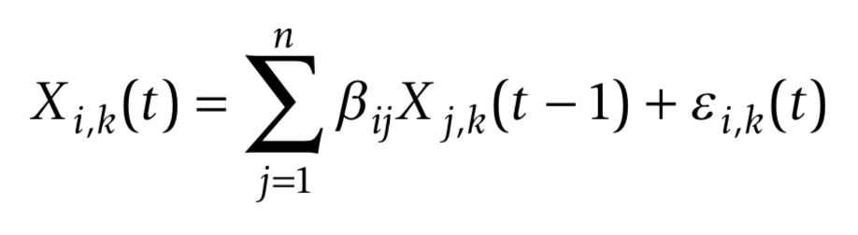
Idiographic Assessment: Graphical Autoregressive Models
k = subjects
i = item
j = item
t = assessment point
Personality
Cognitive Affective
Rude
Quiet
Lazy
Relaxed
Depressed
Outgoing
Kind
Reliable
Worried
Academic Motivation
Around Others
Connected
Positive Emotion
Negative Emotion
Authenticity
Self-Esteem
Happiness
Loneliness
Wild et al., 2010; Epskamp, Waldorp, Mõttus, & Borsboom (2018)
Notes:
On the modeling side, I’ve framed this talk around one type of model, but there are a a number of different models that can be used for idiographic modeling with repeated measures. The model I’m using is called graphical vector autoregressive models. Specifically the procedure for the models I’ll show you come from a procedure outlined by Wild and colleagues and implemented in the R package graphicalVAR. These models are actually quite straightforward, calculating bi-directional cross-lagged associations among indicators

Slide 6
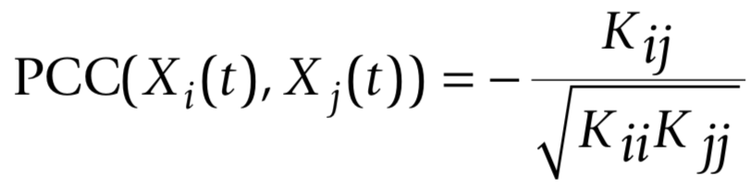
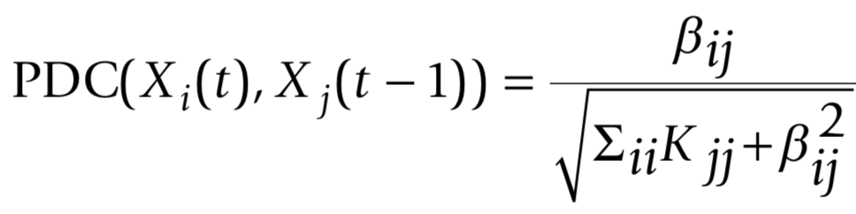
Idiographic Assessment: Graphical Autoregressive Models
k = subjects
i = item
j = item
t = assessment point
K = concentration matrix
(inverse variance-covariance matrix)
Wild et al., 2010; Epskamp, Waldorp, Mõttus, & Borsboom (2018)
Notes:
For each model, these cross-lagged associations can be standardized to estimate relationships on two scales, representing relationships among indicators as partial correlations. The results of the model can further be regularized, such that relationships that are likely to be spurious are set to 0. This is great because it allows the model to choose and fit only those relationships that meaningful and important to the person whose personality is being modeled.
The resulting networks look like this

Slide 7
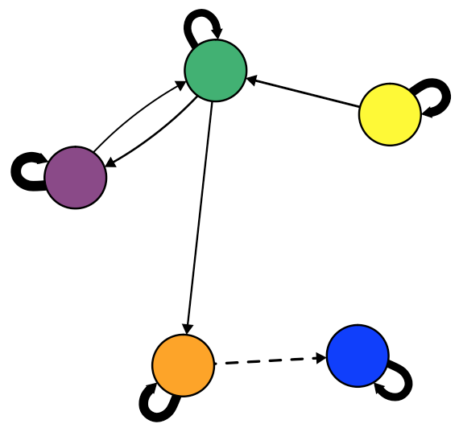
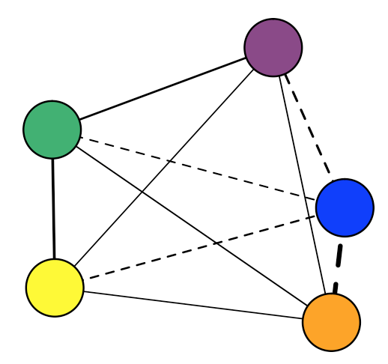
Epskamp, Waldorp, Mõttus, & Borsboom, 2017
Notes:
And represent one contemporaneous within-time network and one temporal cross-lagged network.

Slide 8
Contemporaneous
Concurrent behaviors: While…
Within Time-Points:
X_{it}←→X_{jt}
Epskamp, Waldorp, Mõttus, & Borsboom, 2017
Notes:
Contemporaneous networks represent within-time point relationships of concurrent behaviors, controlling for cross-lagged relationships, and answer the question of “while”. For example, while I am being outgoing, I may be worried or anxious at the same time.

Slide 9
Contemporaneous
Concurrent behaviors: While…
Temporal
Contingent behaviors: If…Then…
Within Time-Points:
X_{it}←→X_{jt}
Between Time-Points:
X_{it}→X_{i, t+1}
Epskamp, Waldorp, Mõttus, & Borsboom, 2017
Notes:
Temporal networks, in contrast, represent between time-point relationships between contingent behaviors, representing if… then relationships between personality manifestations. So, for example, if I am sociable now, I may be less worried in four hours.
Notably, contemporaneous and temporal relationships need not be the same, as in my example of relationships between sociability and worry.

Slide 10
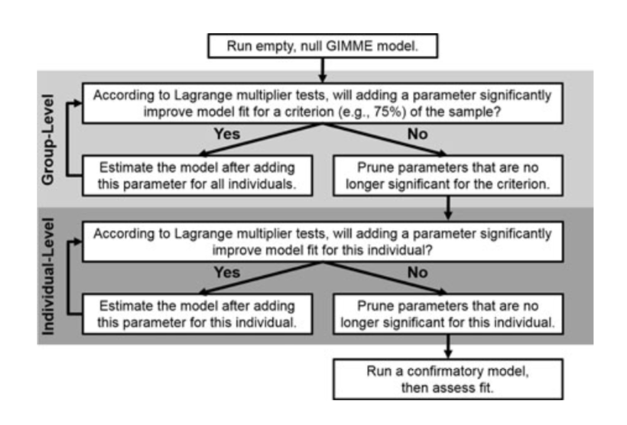
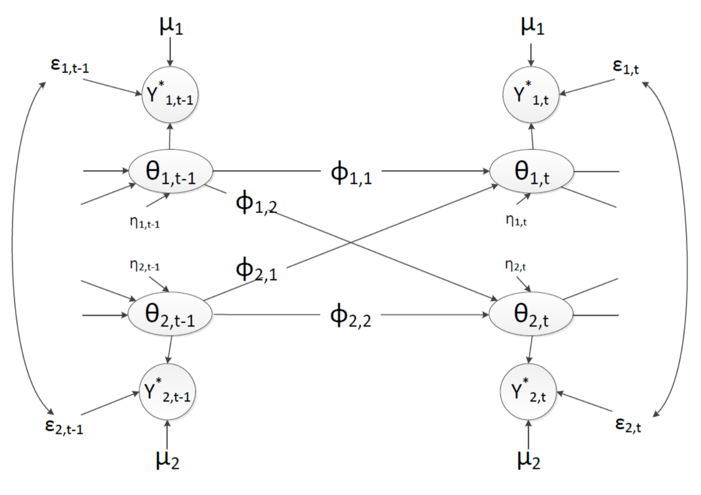
GIMME
VAR Bayesian Dynamic Model
Beltz & Gates, 2017; Wright et al., 2017
Krone, Albers, Kuppens, & Timmerman, 2017
Notes:
A quick plug. I’m using one model to construct these idiographic networks, but there are two others that I’d like to highlight. The first is the GIMME, which is a really cool model that iteratively links individual and group level analyses. The second uses Bayesian estimation to estimate several different dynamic measures, including the autoregressive cross-lagged relationships I've highlighted thus far, that I will not have time to highlight today.

Slide 11
Promises | Challenges
What does idiographic assessment and modeling buy us, and how do we do it well?
Notes:
Today, though, I want to talk about the promises and challenges facing the application of idiographic assessment and techniques to personality. These are principles I’ve developed from years of working with individual-level data and from facing the practical considerations of doing so. For each of these, we can answer questions often addressed from a nomothetic perspective from an idiographic one, something that has almost never been done due to a variety of reasons. But these are worthwhile questions if for no other reason that we don’t know the answers because they have not been tested. So, my goal is for you to walk away today with a new appreciation of where work on idiographic assessment stands and where we go next.
add some sort of comparison to nomothetic approaches
make connections to each how we would normally look at these
FA, mediation, etc. similar questions but at different levels

Slide 12
Promises | Challenges
Structure
Notes:
First, I’ll talk about how idiographic analyses inform the study of personality structure, highlighting intraindivudal structure. Past work has approached questions of personality structure using data reduction techniques, like factor analysis, but we will tackle the same question from an idiographic network framework

Slide 13
Promises | Challenges
Structure
Process
Triggering Situations
Expectancies
States /
State
Expression
Re-
Actions
Notes:
Second, I’ll talk about how idiographic techniques can help us to answer questions of process – what are the mechanisms that underlie personality and how can we incorporate them into our measurement models? Nomothetically, this has been addressed by adding single process components within a mediation model, but with idiographic models, we can make these specific to the person

Slide 14
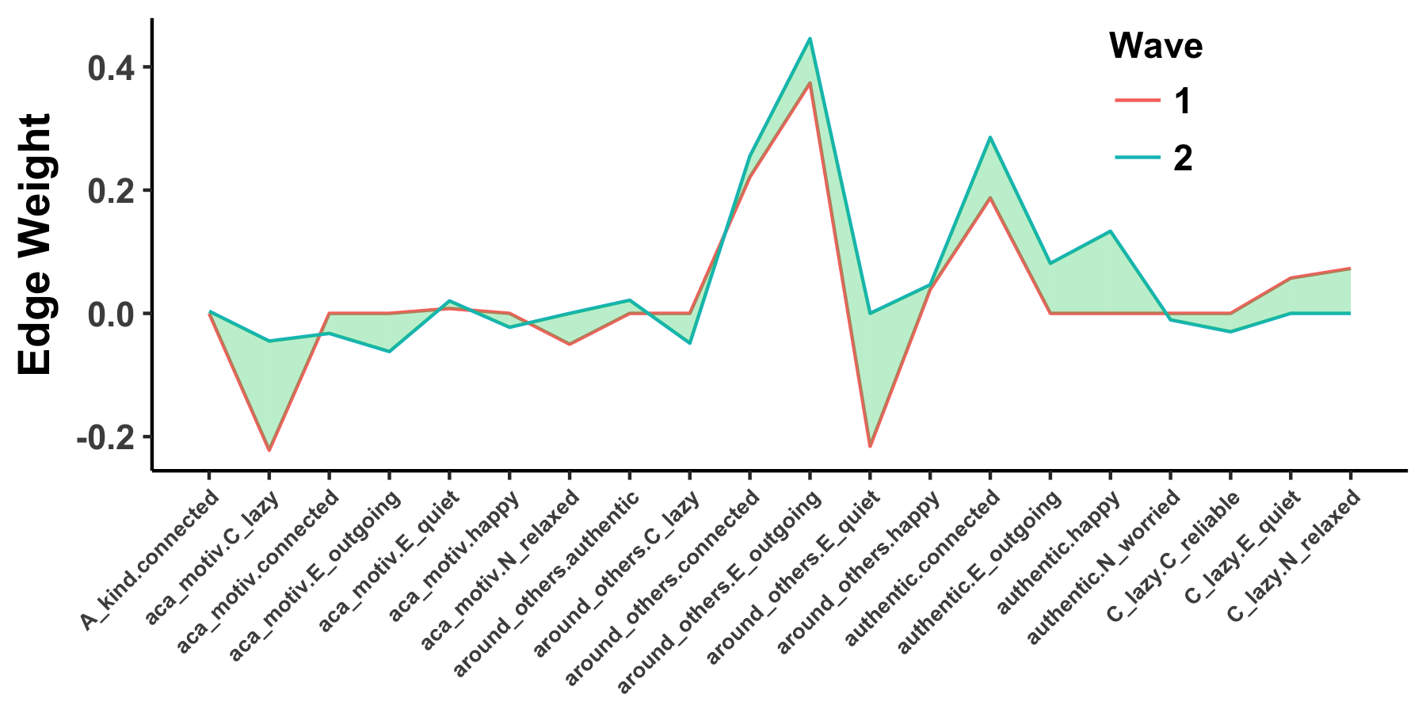
Promises | Challenges
Structure
Process
Triggering Situations
Expectancies
States /
State
Expression
Re-
Actions
Development
Notes:
Third, I’ll talk about how idiographic personality networks can help us to answer questions of personality development. Personality development is often addressed by looking at mean level and rank order change of populations, rather than idiographic change within a person.

Slide 15
Promises | Challenges
Structure
Process
Triggering Situations
Expectancies
States /
State
Expression
Re-
Actions
Development
psyarxiv.com/pb92q
Notes:
Third, I’ll talk about how idiographic personality networks can help us to answer questions of personality development. Personality development is often addressed by looking at mean level and rank order change of populations, rather than idiographic change within a person.

Slide 16
Promises | Challenges
Structure
Notes:
First, turning to personality structure, which from an idiographic perspective, is the stable personal tendencies within a person, or the consistent temporal and contemporaneous behavioral patterns across assessments.
Here I’m going to show you a series of idiographic contemporaneous networks on the left and the profile of the edge weights on the right.

Slide 17
Promises | Challenges
Structure
Academic motivation – lazy
Notes:
Weights are on the x-axis, while the particular edges are on the y axis. Different networks will be different lines. For this participant, you can see that relationships differ across edges, with many at or near 0, and some more extreme edges much stronger, such as the negative relationship between academic motivation and laziness.

Slide 18
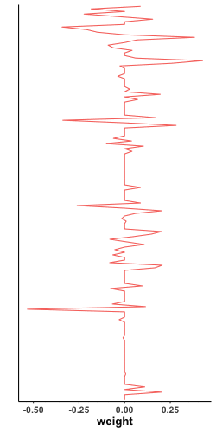
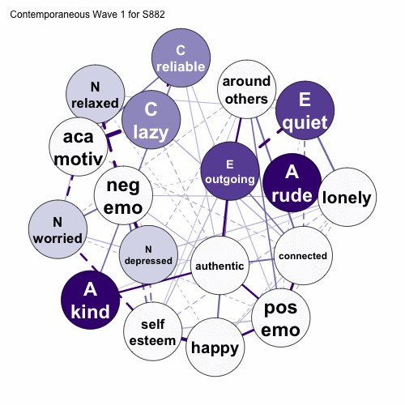
Promises | Challenges
Structure
Notes:
Now, we can watch the profile of each network be added to the figure on the right. As we do so, two things become clear: first, there are individual differences in both the direction and maginitude of different relationshps. Second, there are a lot of similarities. Note the areas that are either white, indicating that no one showed that relationship or or strongly colored, indicating strong shared relationships for certain edges.
some sort of example or context

Slide 19
Promises | Challenges
Structure
Notes:
These temporal and contemporaneous networks can help to answer questions of interindividual differences in intranidal structure.

Slide 20
Promises | Challenges
Structure
Temporal
Contingent behaviors: If…Then…
X₁₁
X₁₂
X₁₃
. . .
X_{1j}
X₂₁
X₂₂
X_{2j}
X₃₁
X_{3j}
. . .
. . .
. . .
X_{i1}
. . .
X_{ij}
Between Time-Points:
X_{it}→X_{i, t+1}

Slide 21
Promises | Challenges
Structure
Contemporaneous
Concurrent behaviors: While…
1
X₁₂
X₁₃
. . .
X_{1j}
X₂₁
1
X_{2j}
X₃₁
X_{3j}
. . .
. . .
. . .
X_{i1}
. . .
1
Within Time-Points:
X_{it}←→X_{jt}

Slide 22
Promises | Challenges
Personality Processes
T riggering Situations
E xpectancies
S tates /
S tate
E xpression
R e-
A ctions
Wrzus & Roberts, 2017
Notes:
Second, idiographic personality networks can offer insight into the processes or mechanisms that underly why and how personality manifests. One useful framework for considering personality processes is the TESSARA framework.

Slide 23
Promises | Challenges
Personality Processes
T riggering Situations
E xpectancies
S tates /
S tate
E xpression
R e-
A ctions
Wrzus & Roberts, 2017
Notes:
which stands for triggering situations, expectancies, states / state expression, and reactions.
Could take this like “using a lasso technique or filtering method, we can see which situations, expectancies, states, and reactions are critical to a person and drop those that aren’t”
Could also talk about this in an interative sense, like “we could add studying and see how much more ariance is explained overall and how much less in other model terms”

Slide 24
Promises | Challenges
Personality Processes
T riggering Situations
E xpectancies
S tates /
S tate
E xpression
R e-
A ctions
Notes:
Within personality networks, we can place the components of the TESSERA framework directly into the network, such as triggering situations like being around others, state / state expressions like academic motivation, and expectancies like authenticity
Again, using the graphical lasso technique or another filtering method, we can see which situations, expectancies, states, and reactions are critical to a person and drop those that aren’t. In other words, we can test for processes of personality that are unique to an individual and those are shared across individuals.
could look at these nomothetically, but this allows us to model the structure and process together
applies to any ID or anytthing esle, e.g. emotion

Slide 25
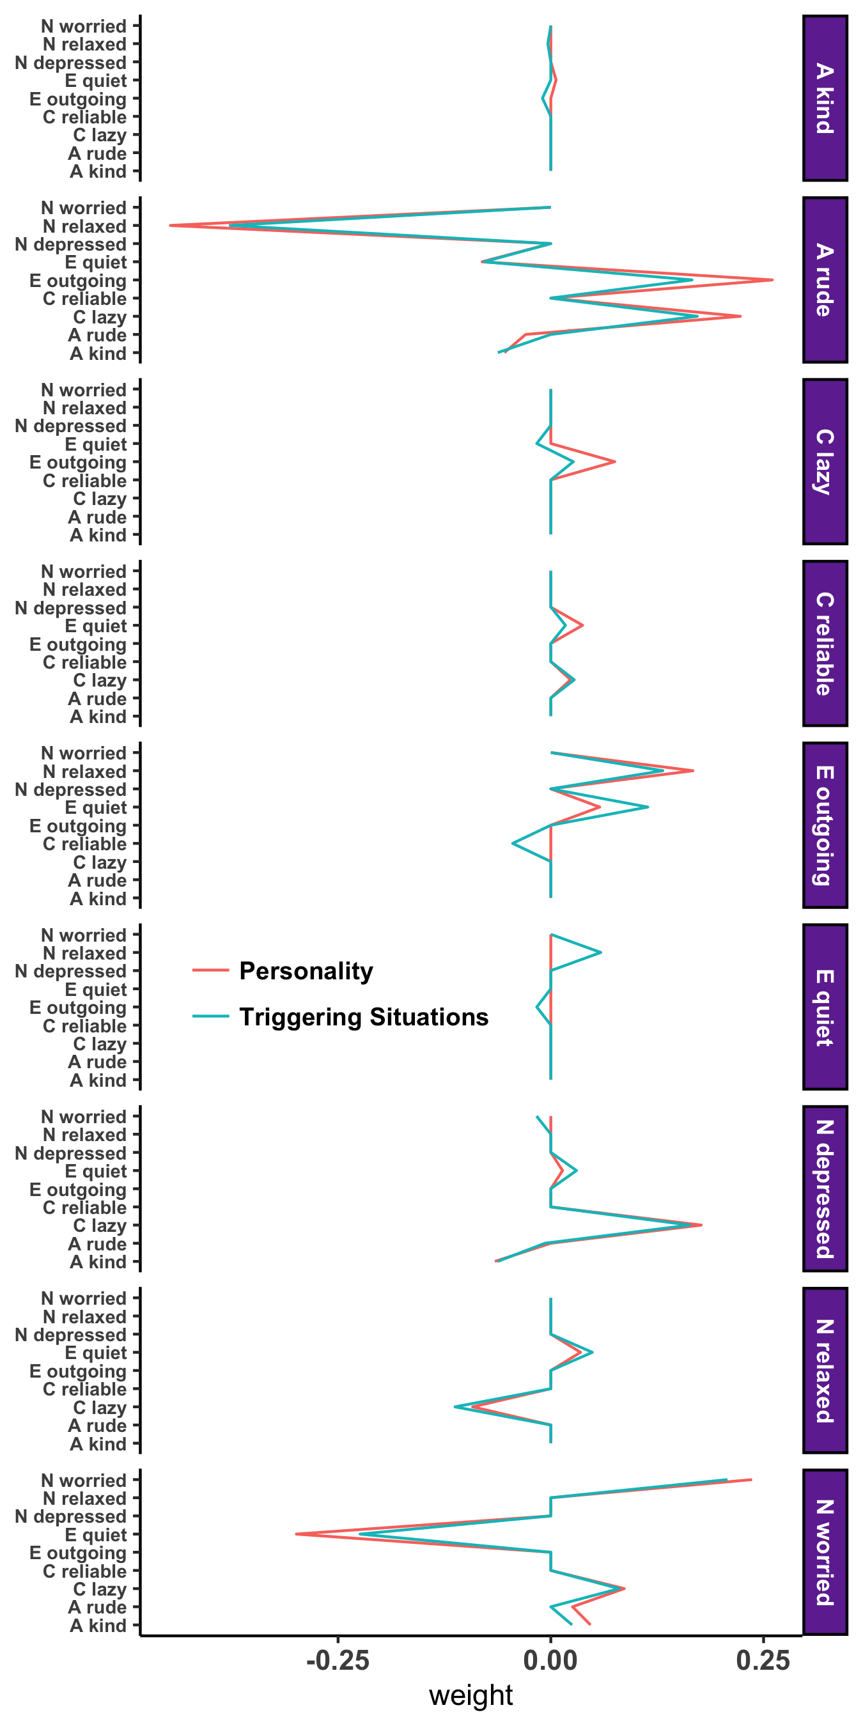
Promises | Challenges
Personality Processes
Personality
Triggering Situations
Expectancies
State / State Expressions
Notes:
There aren’t great changes in the resulting network, but you can see that current personality manifestations of future depression are influenced – there are differences in the two networks

Slide 26
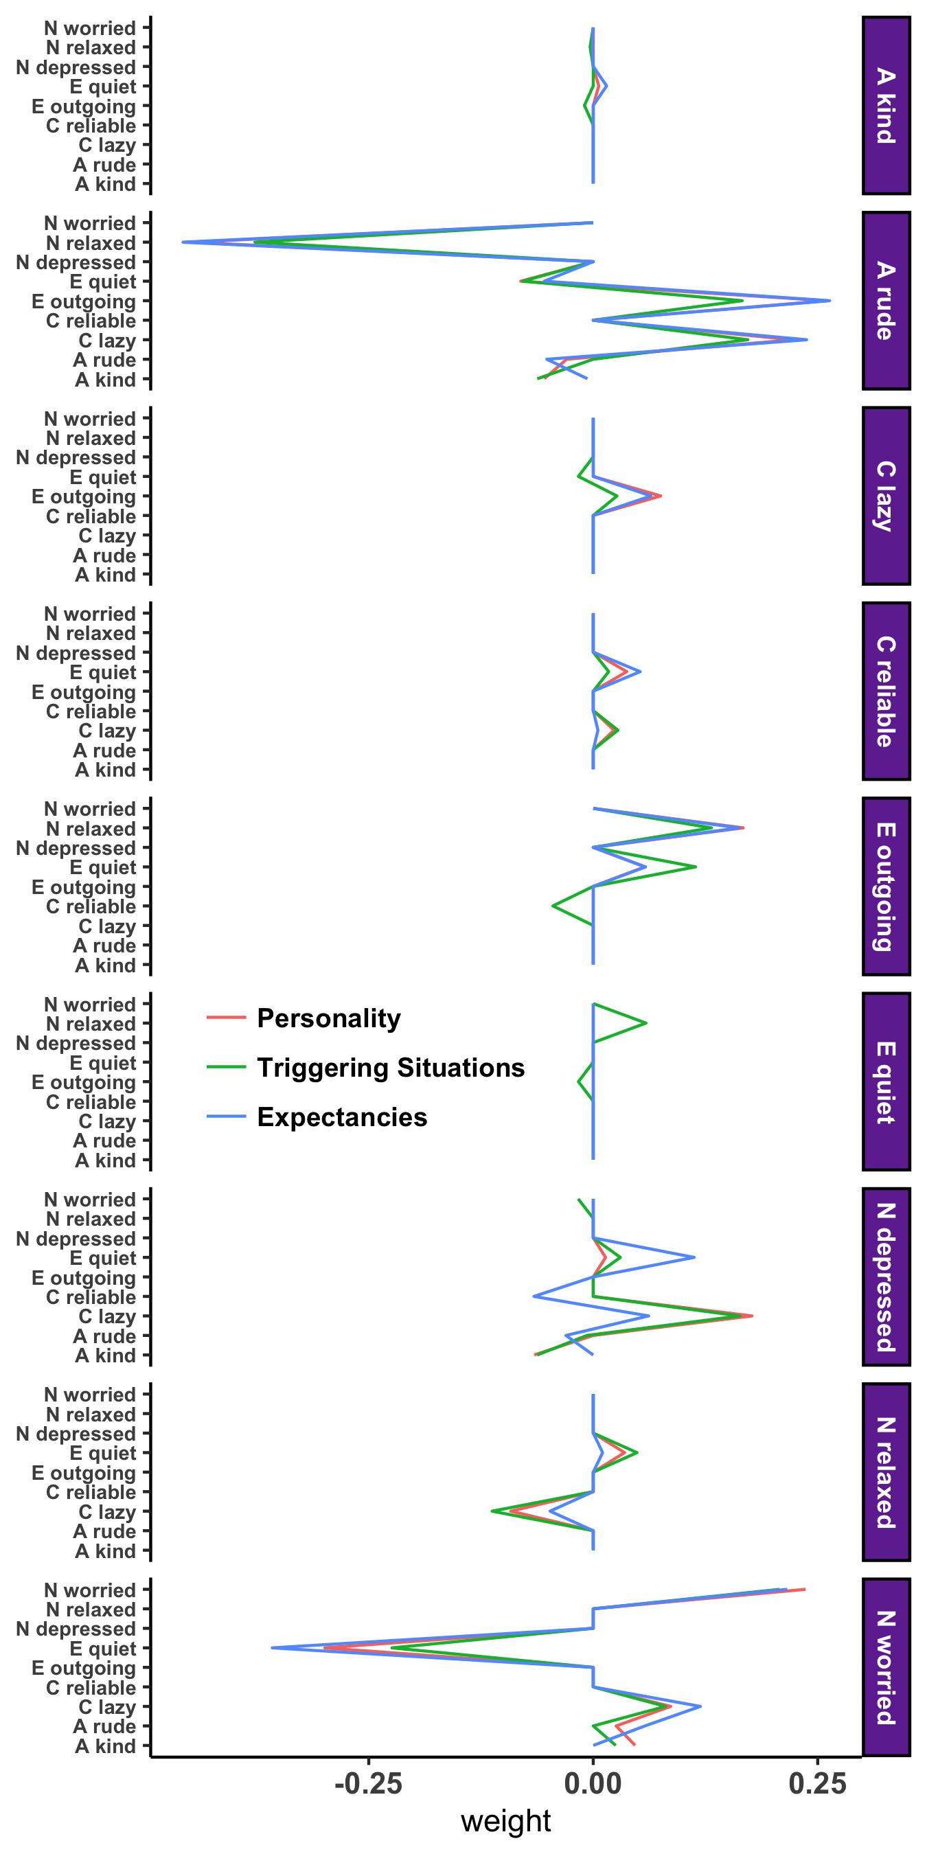
Promises | Challenges
Personality Processes
Personality
Triggering Situations
Expectancies
State / State Expressions
Notes:
When we add an expectancy to the network, we see an even greater influence on the network

Slide 27
Promises | Challenges
Personality Processes
Personality
Notes:
One way to think about this is to build networks with “traditional” manifestations of personality and then iteratively add single processes and examine how its addition influences the relationships among personality manifestations. So here you see a temporal personality network with 9 nodes of personality manifestations and the relationships among them.
Now, observe what happens when I add in a triggering situation

Slide 28
Promises | Challenges
Personality Processes
Personality
Personality + Triggering Situations
Notes:
And then we can add an expectancy and observe the change

Slide 29
Promises | Challenges
Personality Processes
Personality
Personality + Triggering Situations
Personality + Expectancies
Notes:
And finally we’ll add a personality state and observe the change

Slide 30
Promises | Challenges
Personality Processes
Personality
Personality + Triggering Situations
Personality + Expectancies
Personality + State Expression
Notes:
It’s a little difficult to observe the changes that happen here, so we look at the profiles of edge weights like we did before and see how adding these processes influences the relationships among the prsoanlity manifestations

Slide 31
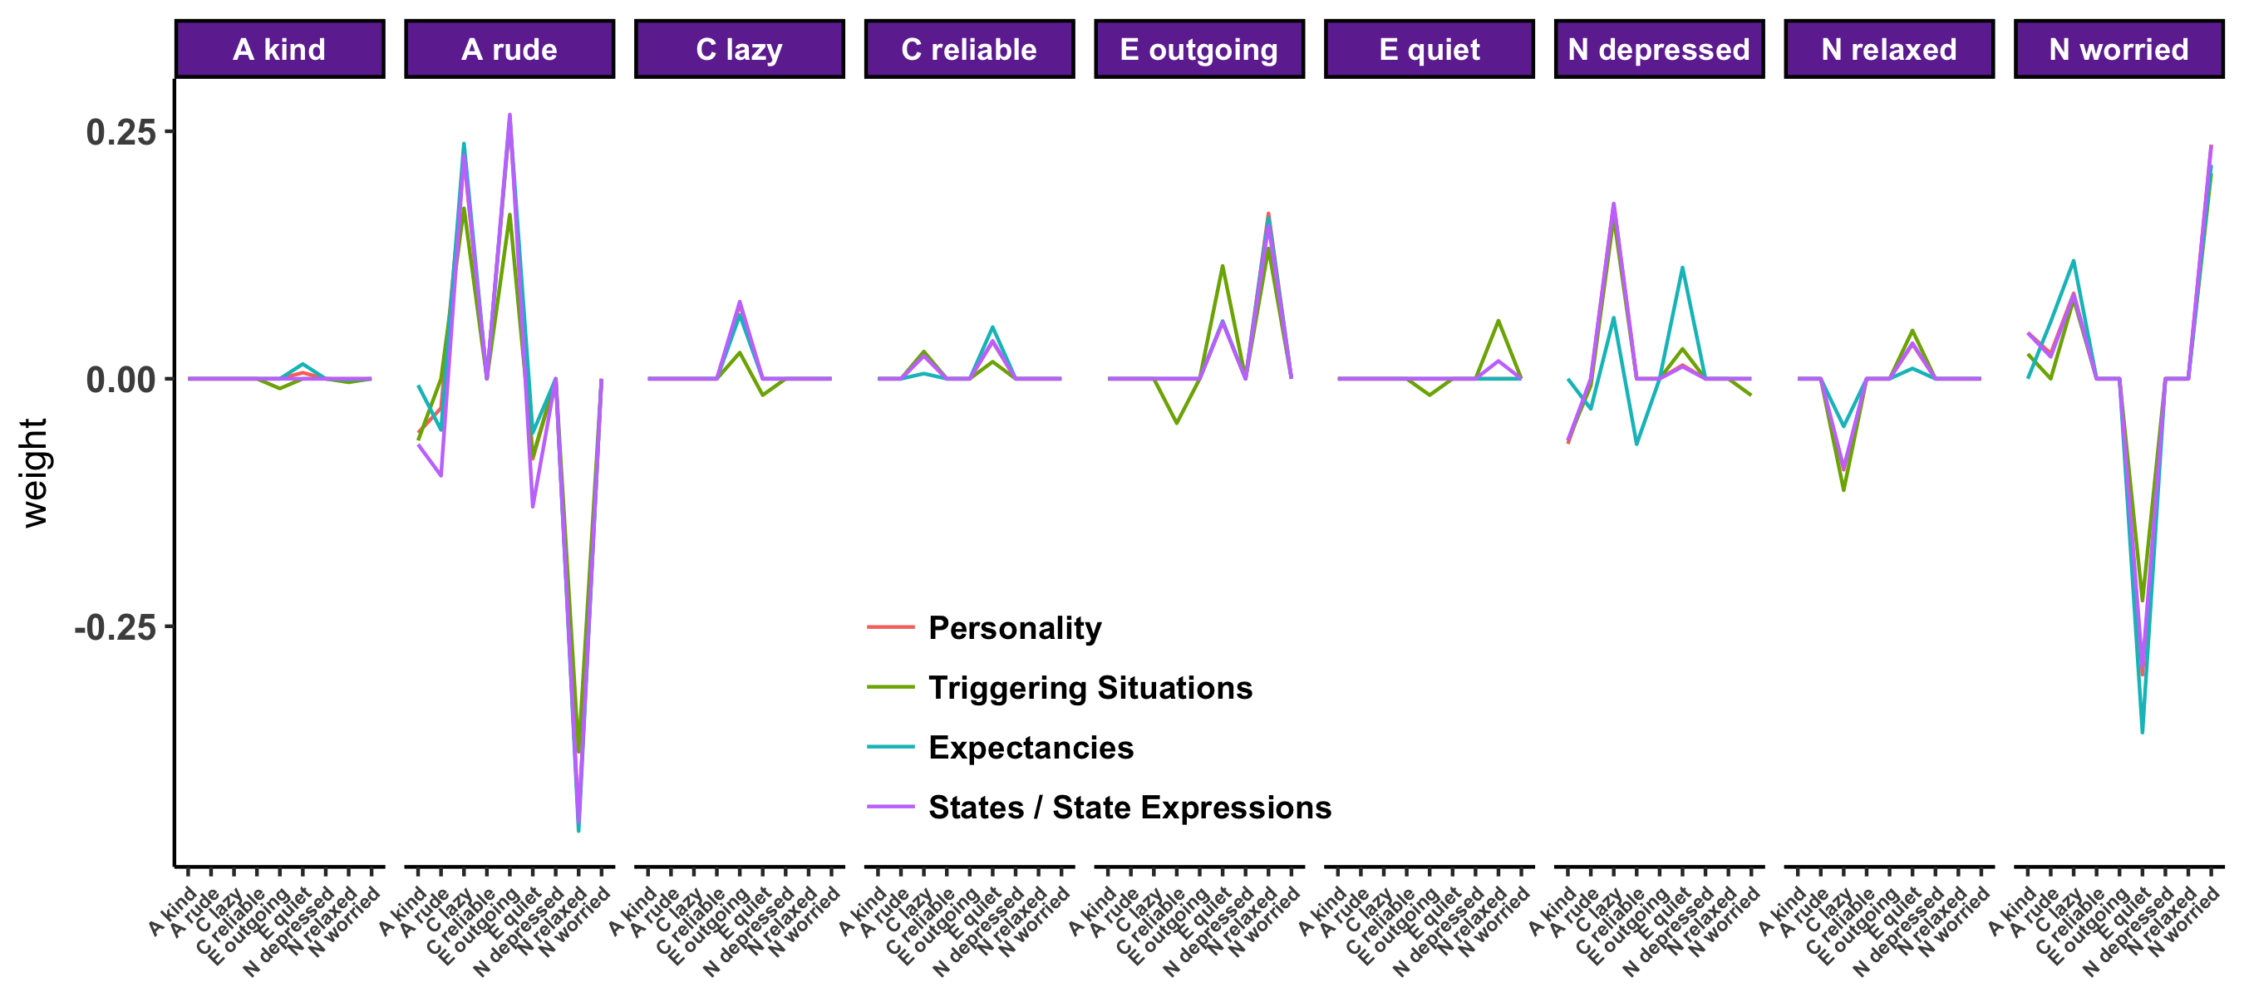
Promises | Challenges
Personality Processes
Notes:
We can place these back into the profiles we examined before to see how the addition of the TESSERA components influenced the structure of the persoanlity network.
For Triggering Situations and States, we see few changes from the line representing the network with only personality manifestations
But for the network also containing an expectancy, we see a few changes in their network structure
CLICK

Slide 32
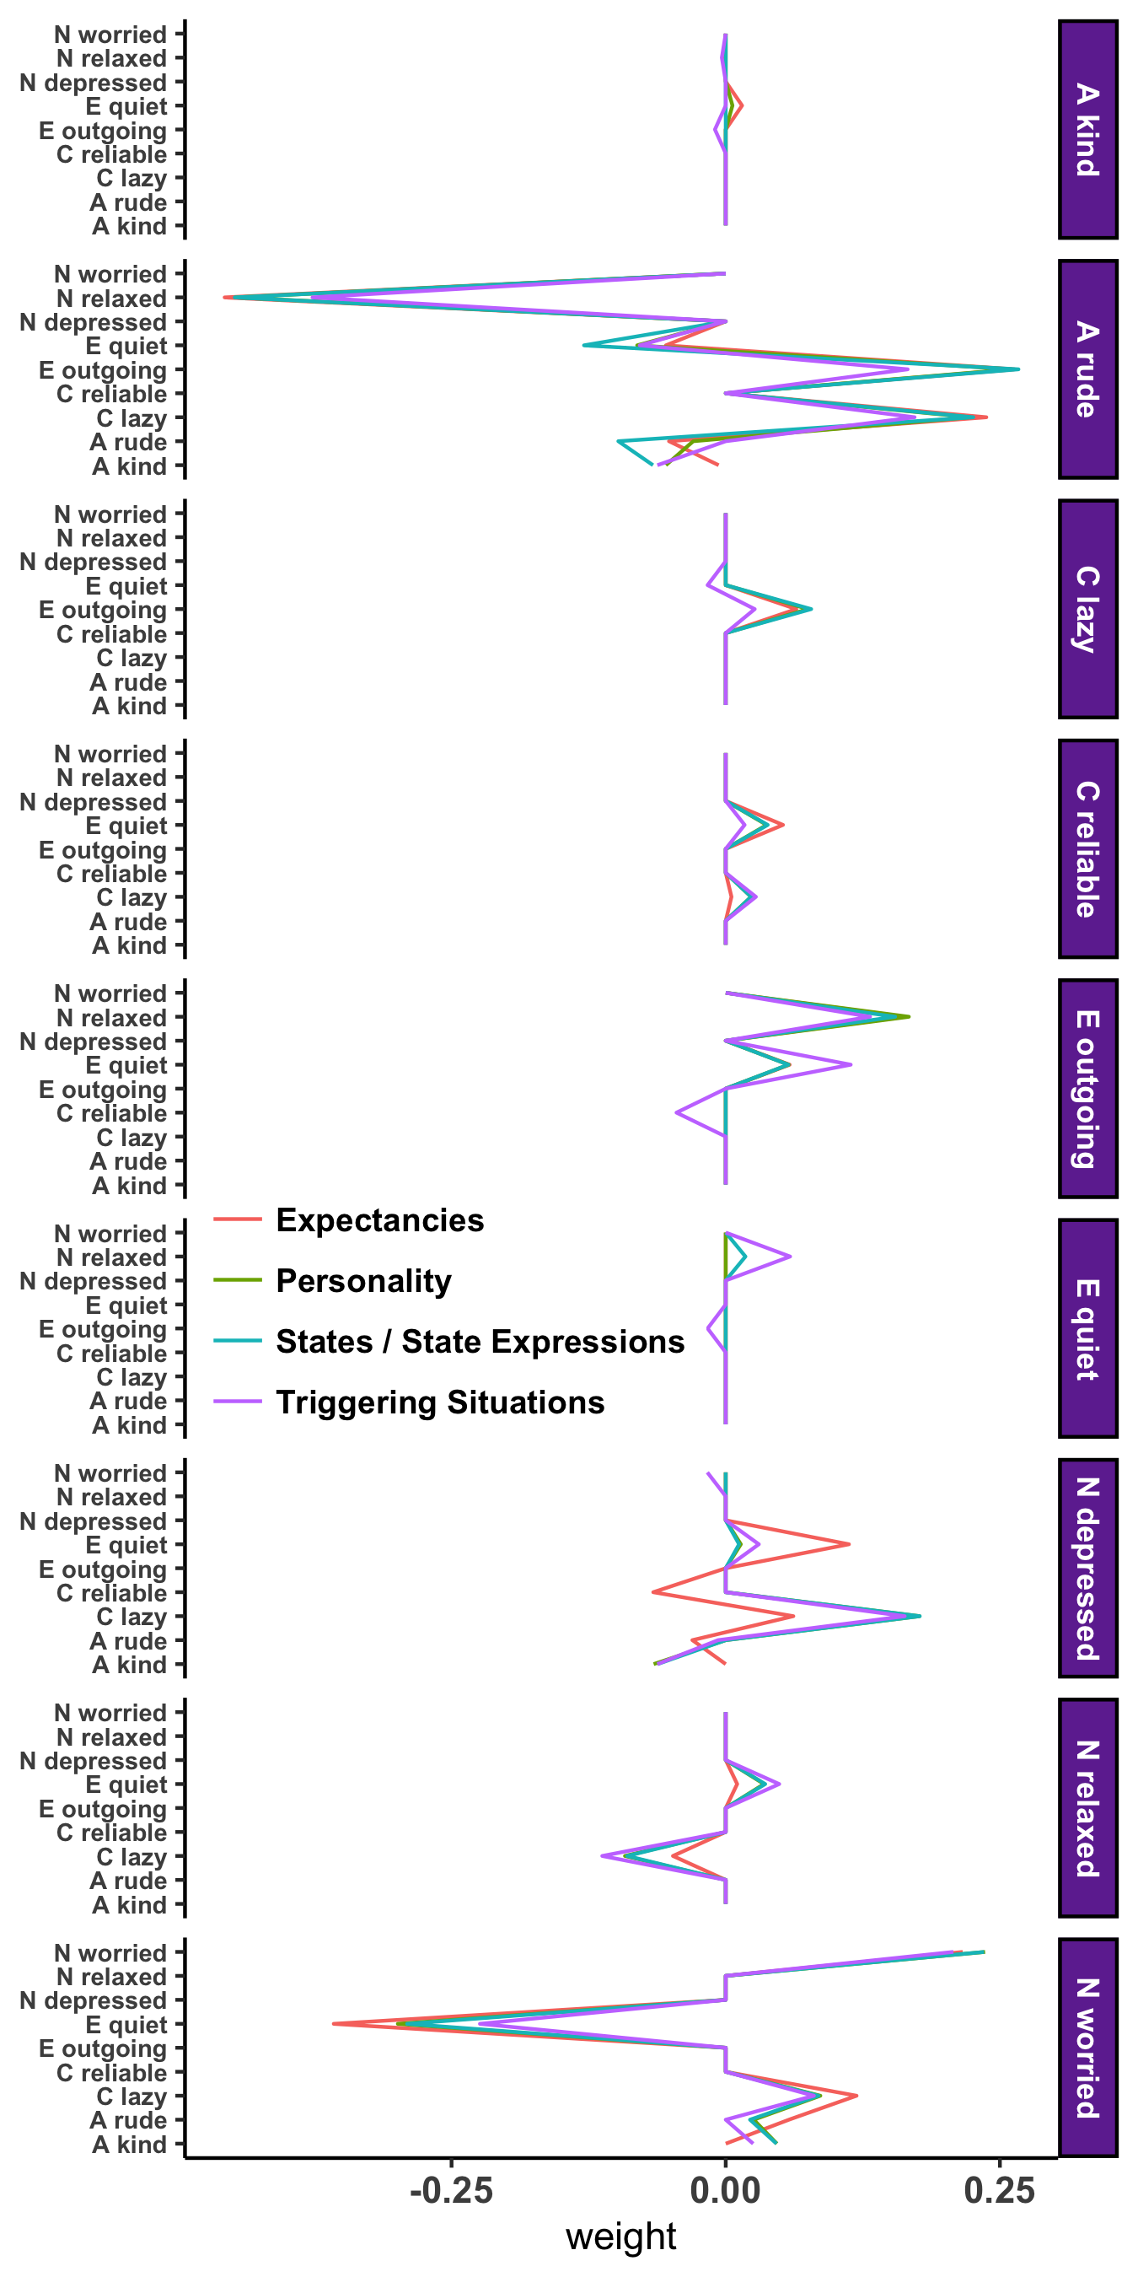
Promises | Challenges
Personality Processes
Notes:
Zooming in, we see that adding the expectancy (academic motivation) to the network, influences the relationship between current personality manifestations and future depression, with, for example a weaker positive relationship between current laziness and future depression, suggesting that academic motivation influences this if…then contingency
Bringing it all together, current manifestations of personality’s prediction of future depression are influenced by different processes of personality. Most notably, expectancies strongly influence behavioral patterns – that is, expectancies explain the patterns of behavior that underlie personality manifestation.

Slide 33
Promises | Challenges
Development
Beck & Jackson (under review)
Notes:
Finally, idiographic personality networks can inform our understanding of personality development. Instead of conceptualizing personality development as mean level or rank order change across people over time, we can examine change within a person relative to him or herself.

Slide 34
Promises | Challenges
Development
Beck & Jackson (under review)
Notes:
Consider the two networks you see here. They represent data collected from the same individual one year apart. As you can see from the profile on the right, there was some consistency in the participants’ profile over two years as evidenced by the correlation you see at the top of the profile, but there was also a large degree of change, as evidenced by the differences between the red and blue lines on the profile.

Slide 35
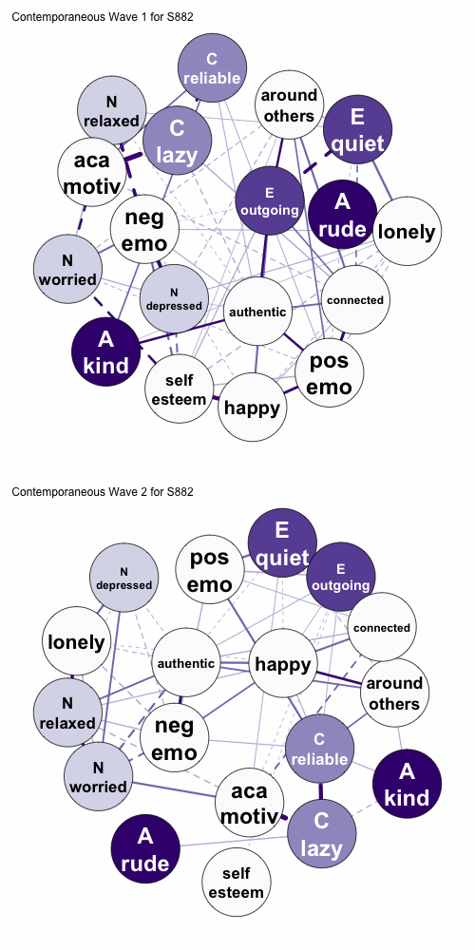
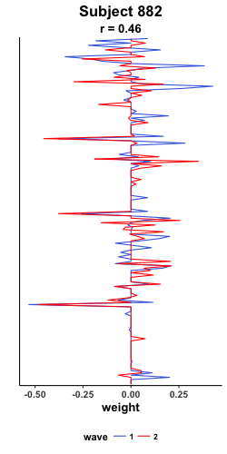
Promises | Challenges
Development
Beck & Jackson (under review)
Notes:
We can then look at this for every participant in our sample and collect the correlation of their ipsative consistency into a distribution.

Slide 36
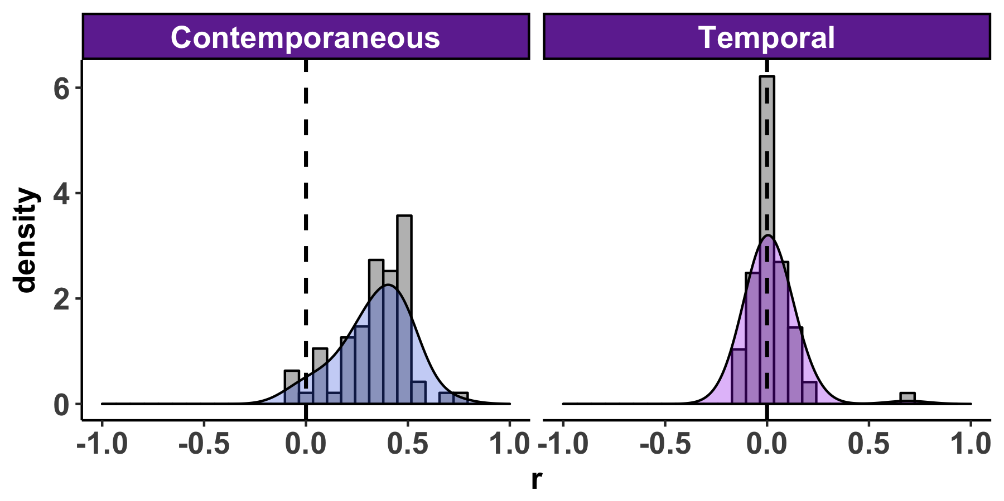
Promises | Challenges
Development
Beck & Jackson (under review)
Notes:
At least within this sample, idiographic contemporaneous (within time point) networks were more consistent than temporal (cross time point) networks
Why does this occur? In other words, are we capturing measurement error or real change? Split half reliability suggests the change is real but also that there are still many challenges facing idiographic assessment and modeling within psychology, which we’ll now turn to

Slide 37
Promises | Challenges
Other Forms of Dynamics
Krone, Albers, Kuppens, & Timmerman (2017)

Slide 38
Promises | Challenges
Notes:
But idiographic networks are not all sunshine and rainbows. We have a number of important challenges facing us. I’m going to highlight just three of those today, which I think are among the most important challenges we are facing

Slide 39
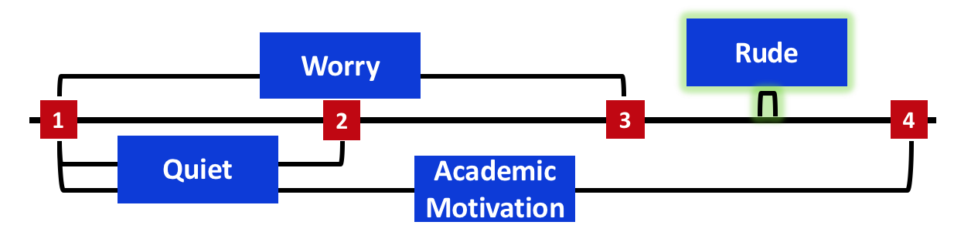
Promises | Challenges
Velocity
Notes:
The first challenge deals with what I’ll call the velocity of psychological processes

Slide 40
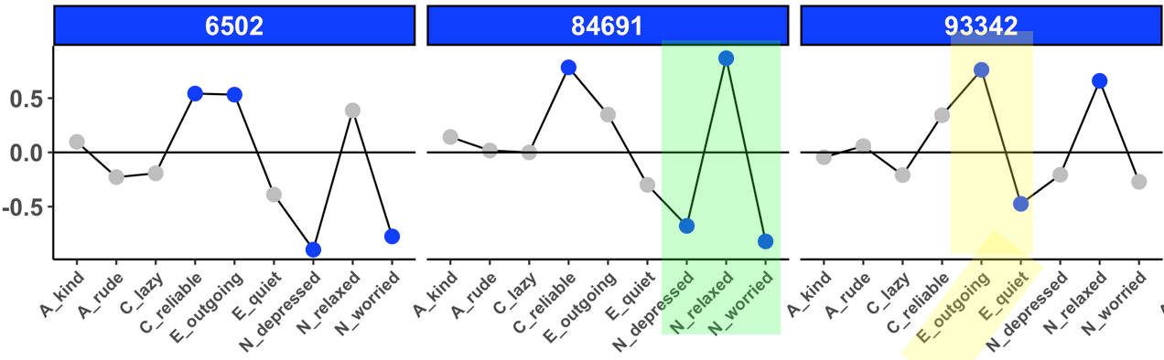
Promises | Challenges
Velocity
Psychometrics
Notes:
The second with the psychometrics of intensive repeated measures and idiographic assessment

Slide 41
Promises | Challenges
The Time Interval Problem
Psychometrics
Aggregation
Centrality
Clustering
Density
Communities
Notes:
And the last deals with the problem of aggregation across a large number of personality networks and people

Slide 42
Promises | Challenges
The Time Interval Problem
4 hours
1
2
3
4
Worry
Academic Motivation
Quiet
Rude
Notes:
First, for velocity, consider the timeline often used in ESM studies, such as the one I’m using as a demo today that collected 2 weeks of responses, 4x per day, 4 hours apart. Do we have any reason to think that the four personality manifestation / processes at the bottom of the screen would unfold at the same rate?

Slide 43
Promises | Challenges
The Time Interval Problem
Worry
1
2
3
4
Academic Motivation
Quiet
Rude
Notes:
Evidence suggests that worry, which is related to rumination tends to show strong autoregressive relationships, suggesting that it is sustained over time

Slide 44
Promises | Challenges
The Time Interval Problem
Worry
1
2
3
4
Quiet
Academic Motivation
Rude
Notes:
But a personality manifestation like quiet is unlikely to unfold the same way. Indeed, given that being quiet is often dependent on social triggers, like being around others, its velocity may well not be captured by a 4 hour time lag

Slide 45
Promises | Challenges
The Time Interval Problem
Worry
1
2
3
4
Quiet
Academic Motivation
continues
Rude
Notes:
Academic motivation, in contrast may have day level patterns but no patterns within a day. In other words, academic motivation may be something you either have or do not have on a given day

Slide 46
Promises | Challenges
The Time Interval Problem
Worry
Rude
1
2
3
4
Quiet
Academic Motivation
continues
Notes:
Finally, similarly to how being quiet is influenced by the presence of others, being rude may be a very momentary and fleeting pattern. Consider the last time when you were rude to someone. Were you rude for a long period or was it more of a one-off incident from which you quickly and immediately recovered? If so, we might fail to capture its experience at all within ESM (it falls within lags) and will never capture autoregressive relationsips because it it a fleeting feeling.

Slide 47
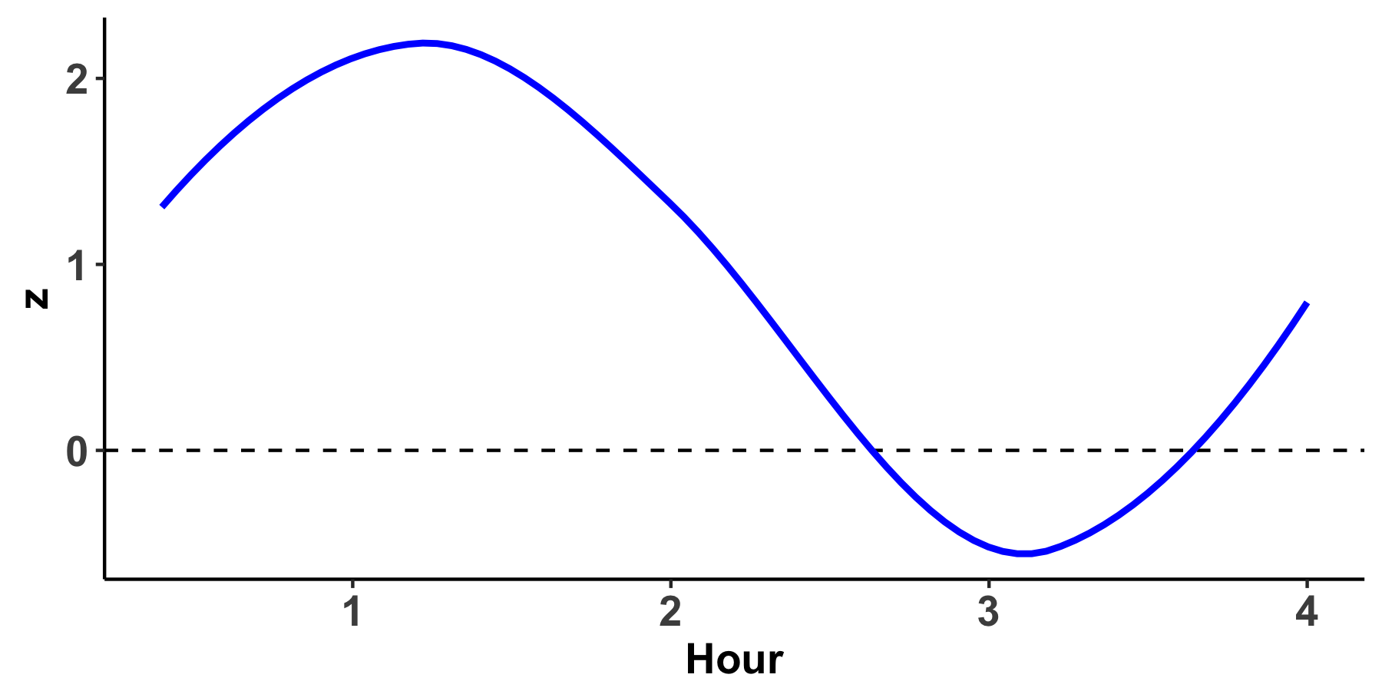
Promises | Challenges
Velocity
Worry
Rude
1
2
3
4
Quiet
Academic Motivation
continues
Notes:
And so the point that I want to get across, is that there is a lot happening in these intervals that we don’t pick up on when we just use four hour time intervals and lagged models

Slide 49
Promises | Challenges
Does cross-lagged behavioral consistency make sense?
Semester 1
Semester 2
8 AM | Wake up
9 AM | Class
10 AM | Study Break
11 AM | Class
12 PM | Class
1 PM | Work
2 PM | Work
8 AM | Class
9 AM | Class
10 AM | Work
11 AM | Work
12 PM | Break
1 PM | Break
2 PM | Class

Slide 50
Promises | Challenges
Consistency as an Individual Difference
Emorie in College
 | Monday | Tuesday | Wednesday | Thursday | Friday
6 AM | Work | Shower | Work | Shower | Work
7 AM | Work | Work | Work | Work | Work
8 AM | Work | Work | Work | Work | Work
9 AM | Shower | Class | Shower | Class | Shower
10 AM | Class | Class | Class | Class | Class
11 AM | Study | Study | Study | Study | Study
12 PM | Study | Study | Study | Study | Study

Slide 51
Promises | Challenges
Consistency as an Individual Difference
Emorie’s Best Friend in College
 | Monday | Tuesday | Wednesday | Thursday | Friday
6 AM | ????? | ????? | ????? | ????? | ?????
7 AM | ????? | ????? | ????? | ????? | ?????
8 AM | ????? | ????? | ????? | ????? | ?????
9 AM | ????? | ????? | ????? | ????? | ?????
10 AM | ????? | ????? | ????? | ????? | ?????
11 AM | ????? | ????? | ????? | ????? | ?????
12 PM | ????? | ????? | ????? | ????? | ?????

Slide 52
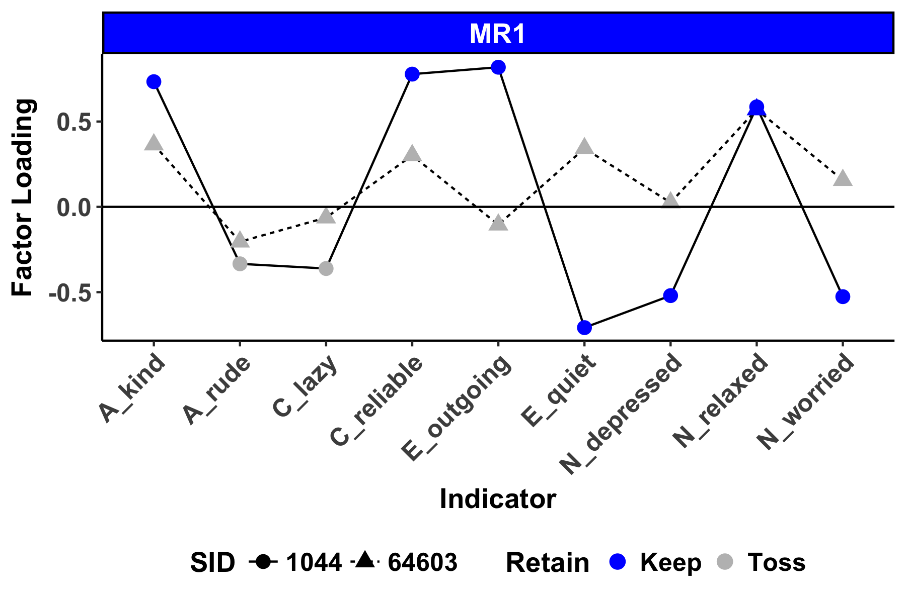
Promises | Challenges
Psychometrics
Borkenau & Ostendorf, 1998;Molenaar, 2004
Notes:
TRANSITION
Second, the idea that individuals can manifest different traits or that the same personality traits can manifest differently raises challenges for psychometrics of the scales used for nomothetic assessment of personality. Consider the factor loadings of these personality manifestations from idiographic p-factor analyses. Blue points represent items that load highly on this factor, while gray items do not. For subject 1, many of the items load onto this factor, whle for subject 2, only one itme does. The same trait is manifesting differently.
soemthing about interpretation differnces

Slide 53
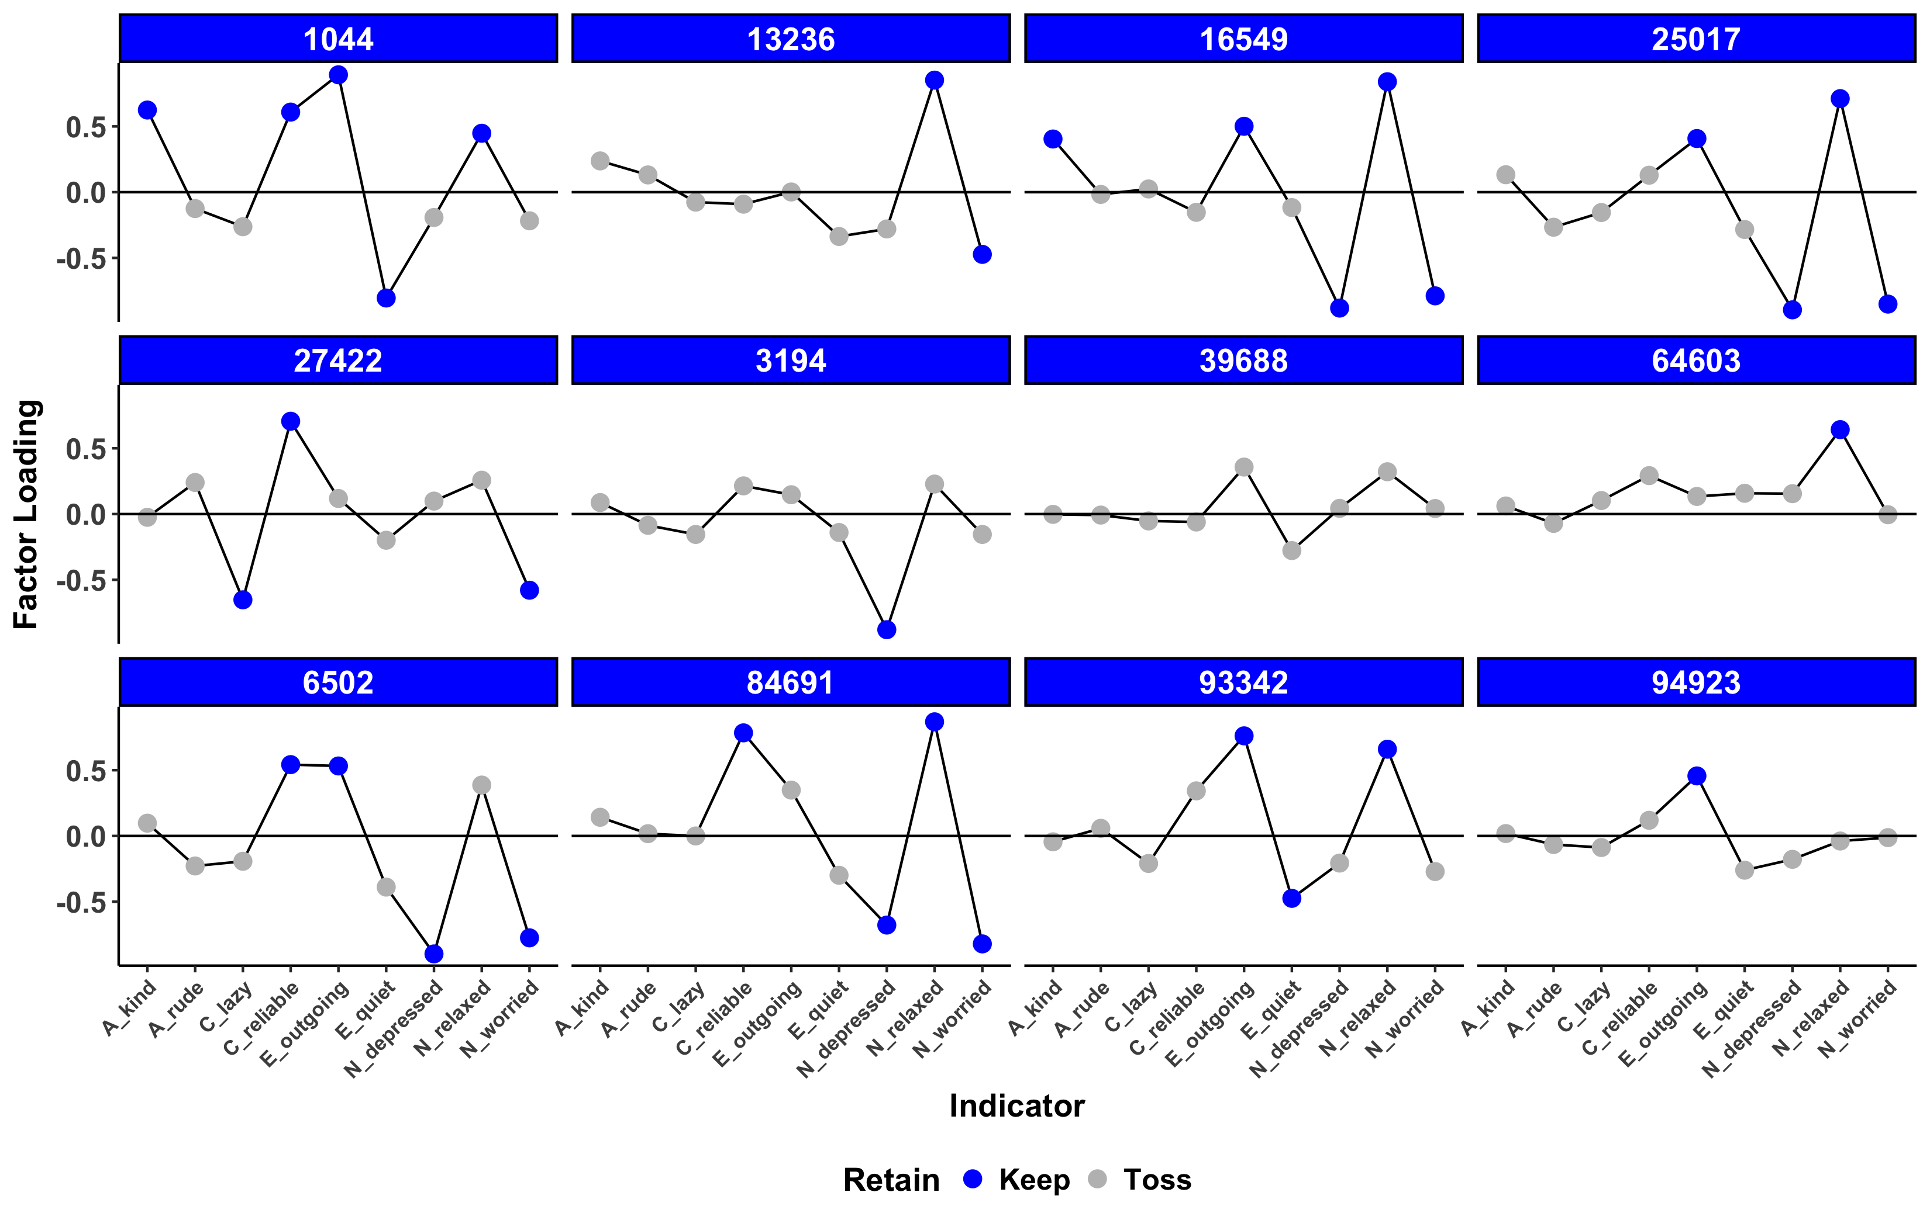
Promises | Challenges
Psychometrics
Notes:
What we can see here is that some of profiles of loading look very similar, like the ones I’ve highlighted in green, but others look quite different, like the ones I’ve highlighted in yellow.
And what I want you to see from this is just that the scales that we have developed differentally apply to individuals which suggests that we need to beign to think about psychometrics on an individual level
We can do this with even more subjects and just the 9 personality items from the BFI, which raises the question of whether it makes sense to ask each participant items that are not relevant to the manifestation of their personality traits. Future research needs to examine new ways of creating and measuring scales, such as adaptive testing used in standardized tests.

Slide 54
Promises | Challenges
Aggregation
Notes:
Finally, the most long-standing issue with idiographic assessment is the question of aggregation. When you estimate a separate model for each person in order to be able to make inferences about individuals, is it possible to also make inferences about populations or to compare individuals?
For example, given these four subjects, what can we say about them and how can we parsimoniously test whether properties of these networks relate to outcomes similarly to how nomothetic assessments of personality predict outcomes.

Slide 55
Promises | Challenges
Aggregation
Centrality
Notes:
By conceptualizing personality as a network, we open up new avenues of summary mesures that are specific to networks, including centrality, which indexes the relative importance of each node within the network. So any node you see here that has many edges incident on it is high in centrality and influences the network.
give exmaples of central items and how to test
something about how centtrality might have unexpected consequences that we dont' understand

Slide 56
Promises | Challenges
Aggregation
Centrality
Density
Notes:
Density, which represents the total number of connections within the network relative to the number of possible connections, so the two network on the top here are high in density, while the bottom two are low

Slide 57
Promises | Challenges
Aggregation
Centrality
Density
Clustering
Communities
Innovation
Variability
Notes:
As well as a number of other network-specific indices like clustering coefficients and community structure, or other dynamic properties that can be assessed within idiographic models like innovation and variability.

Slide 58
Promises | Challenges
Summary
Structure
The Time Interval Problem
Process
Psychometrics
Development
Aggregation

Slide 59
Promises | Challenges
Summary
The Time Interval Problem
Process
Psychometrics
Development
Aggregation

Slide 60
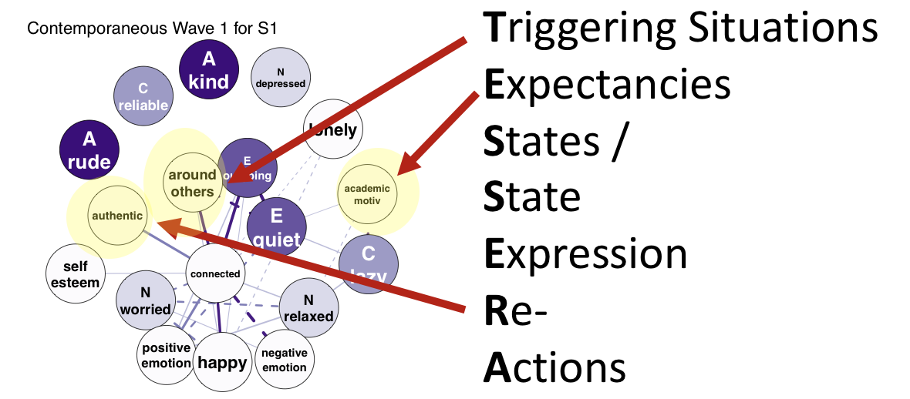
Promises | Challenges
Summary
The Time Interval Problem
Psychometrics
Development
Aggregation

Slide 61
Promises | Challenges
Summary
The Time Interval Problem
Psychometrics
Aggregation

Slide 62
Promises | Challenges
Summary
Psychometrics
Aggregation

Slide 63
Promises | Challenges
Summary
Aggregation

Slide 64
Promises | Challenges
Summary
Centrality
Clustering
Density
Communities

Slide 65


Questions?
Special Thanks to:
Josh Jackson
The PMaD Lab
(And the people who brought us PAIRS data)
Results:
https://pmdlab.wustl.edu/Beck_APS_2018.html
Data and Code:
https://github.com/emoriebeck/APS_2018

Slide 66

Promises | Challenges
Scale Development in ESM

Slide 67
Promises | Challenges
Where do we go from here?
Measurement
Methodology
Modeling

Slide 68
Promises | Challenges
Where do we go from here?
Measurement
Methodology
Modeling
Adaptive Measurement
Pre-Defined Idiographic Assessments
Timing of Personality Manifestations

Slide 69
Promises | Challenges
Where do we go from here?
Measurement
Methodology
Modeling
Adaptive Measurement
Planned Missing Data Designs
Pre-Defined Idiographic Assessments
Longitudinal Assessments
Timing of Personality Manifestations
Intervention Studies

Slide 70
Promises | Challenges
Where do we go from here?
Measurement
Methodology
Modeling
Adaptive Measurement
Planned Missing Data Designs
Sparse Modeling Techniques
Pre-Defined Idiographic Assessments
Longitudinal Assessments
Incorporating additional dynamic measures
Timing of Personality Manifestations
Intervention Studies
Multivariate Dynamic Models

